Slide 1
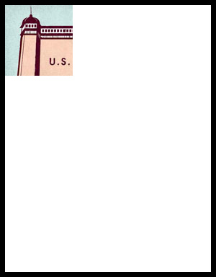
BELL RINGER
WHAT IS THE IMAGE?

Slide 2
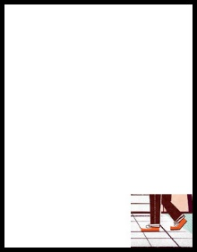
BELL RINGER
WHAT IS THE IMAGE?

Slide 3
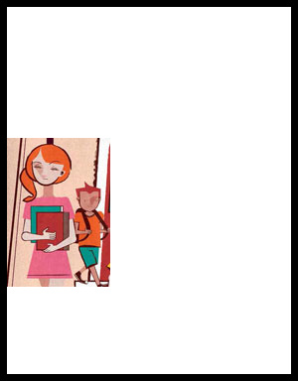
BELL RINGER
WHAT IS THE IMAGE?

Slide 4
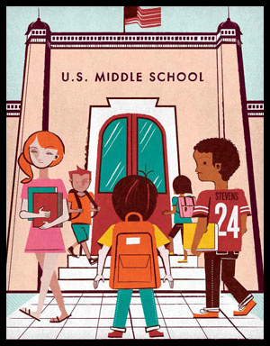
BELL RINGER
WHAT IS THE IMAGE?

Slide 5

BELL RINGER
MULTIPLE PERSPECTIVES
How do we form our opinions about different issues or problems in society?
Why is it important to consider others’ opinions?

Slide 6
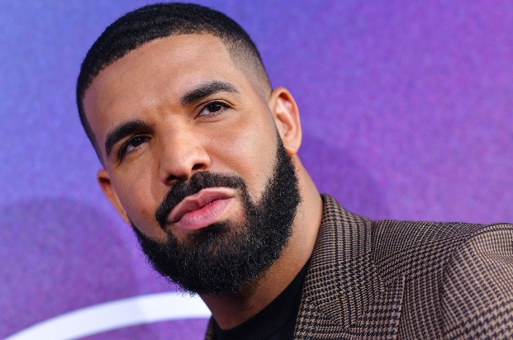
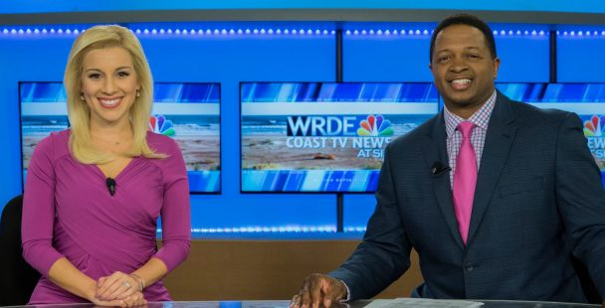
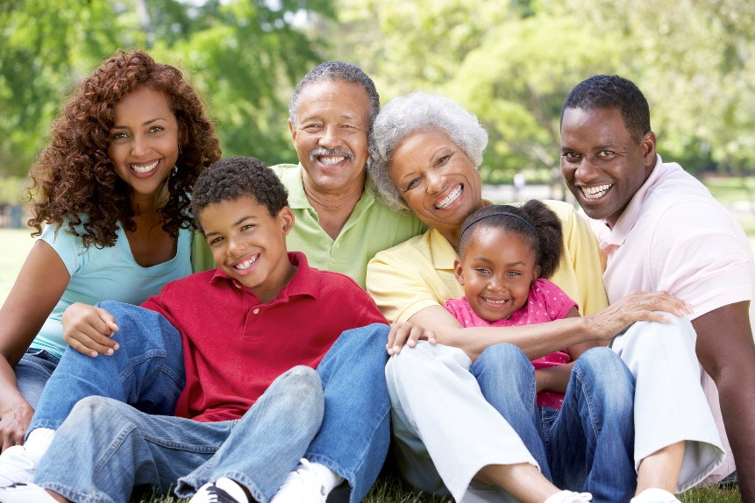
BELL RINGER
MULTIPLE PERSPECTIVES
Our opinions are influenced by:
Family
Friends
Mentors
Media
Celebrities
Politicians
Interest Groups

Slide 7
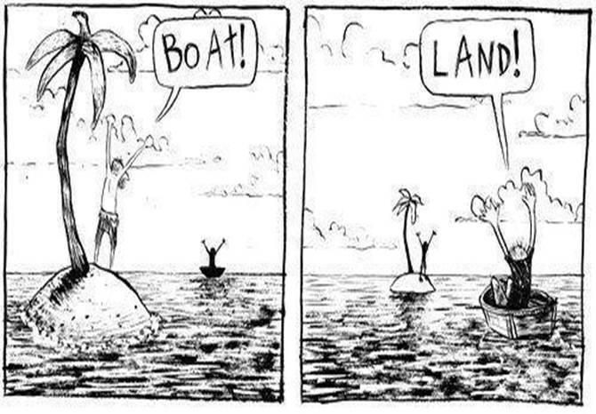
BELL RINGER
MULTIPLE PERSPECTIVES
A perspective is a point of view that someone holds.
Multiple perspectives means that different groups of people have different points of view. It is important that we consider them when we try to solve problems.

Slide 8

BELL RINGER
MULTIPLE PERSPECTIVES
Public opinion is the total of the opinions held about a certain issue.
If one group or individual made its perspective known on an issue, this could influence others to participate, either by agreeing or disagreeing with them.

Slide 9




BELL RINGER
MULTIPLE PERSPECTIVES
Public opinion is often influenced by interest groups, who are people concerned with some particular issue and who try to influence lawmakers to act in their favor.
Examples:
MADD (Mothers Against Drunk Driving)
NRA (National Rifle Association)

Slide 10
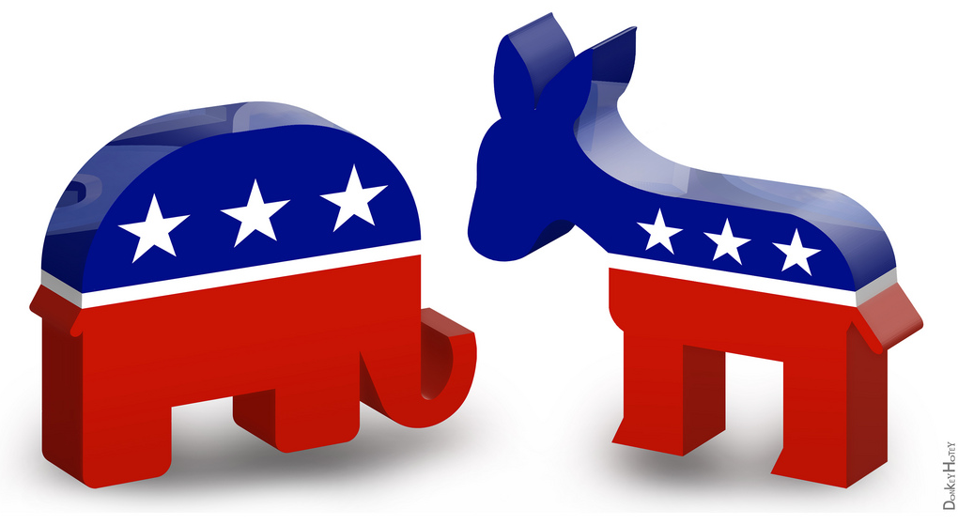
BELL RINGER
MULTIPLE PERSPECTIVES
Public opinion is also influenced by political parties, who are organizations of citizens who have similar views on many issues and who work to put their ideas into effect through government action.
Examples:
Democrats
Republicans

Slide 11
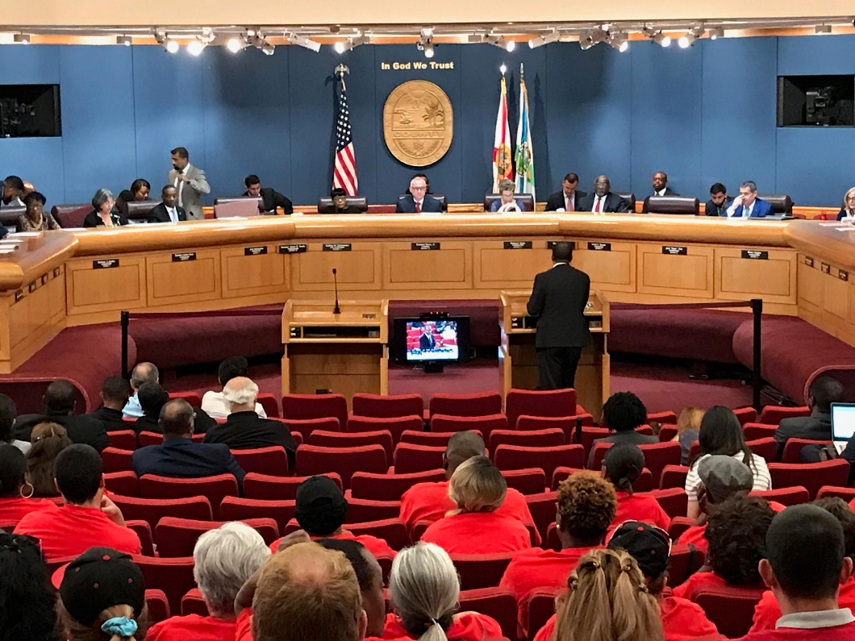
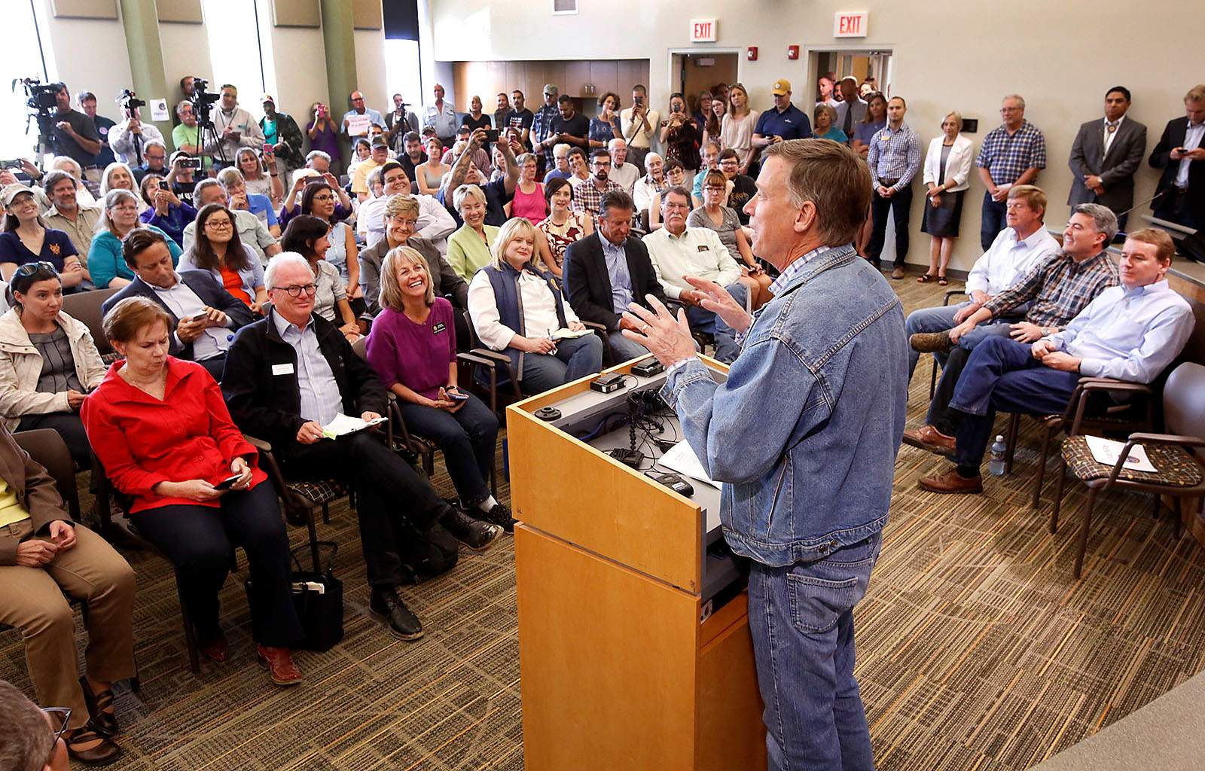
BELL RINGER
TOWN HALL MEETING
Town Hall Meetings are events where lawmakers meet with the public within their district and discuss problems and potential public policy solutions with them.

Slide 12
BELL RINGER
MULTIPLE PERSPECTIVES
You will be assigned a role in your group. Pretend that you are that person (parent, student, business owner, or law enforcement), and approach the given problem from that perspective.
GROUP 1: PARENTS
GROUP 2: STUDENTS
GROUP 3: BUSINESS OWNERS
GROUP 4: LAW ENFORCEMENT

Slide 13
BELL RINGER
TOWN HALL MEETING
Town Hall Meetings are events where lawmakers meet with the public within their district and discuss problems and potential public policy solutions with them.
GROUP 1: PARENTS
GROUP 2: STUDENTS
GROUP 3: BUSINESS OWNERS
GROUP 4: LAW ENFORCEMENT

